Slide 1
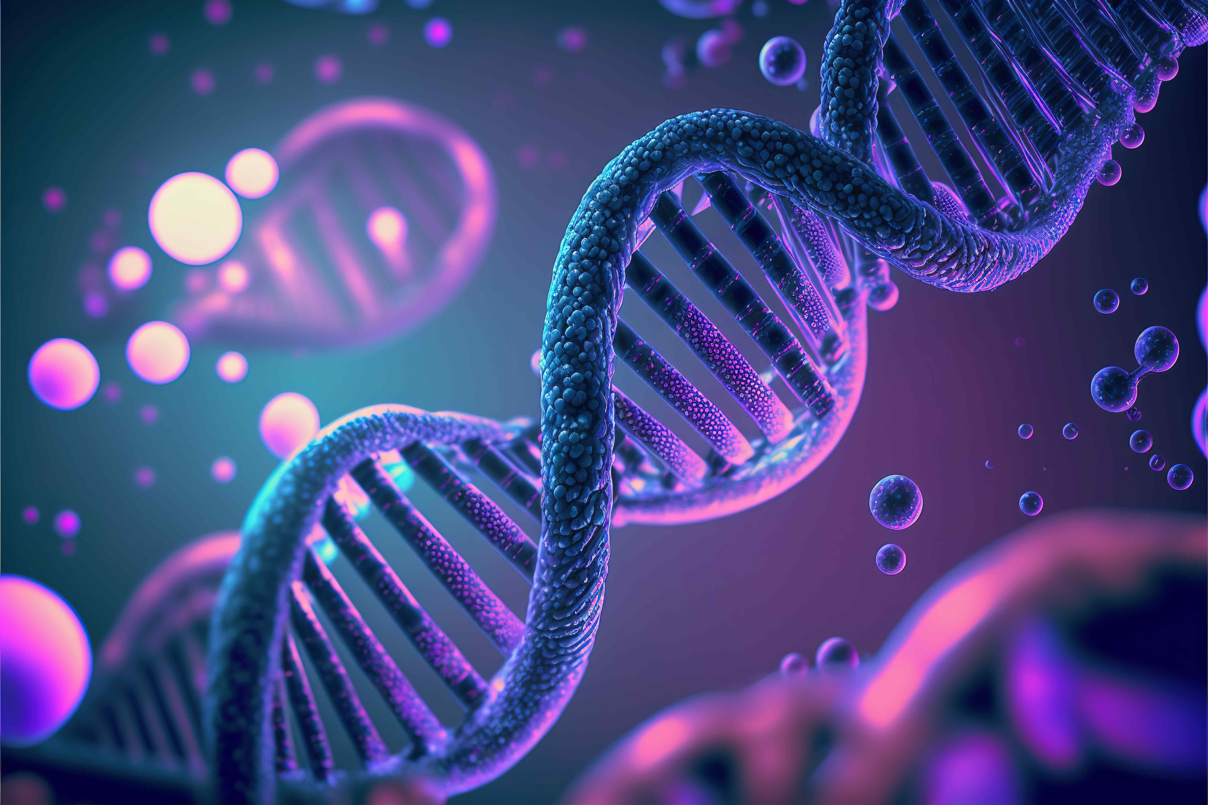

PENGQUIN Genomic Context
VITO Co-promoters: Dr. Bart Buelens + Dr. Gökhan Ertaylan
UGent Promoters: Dr. Ruben Taelman + Dr. Ruben Verborgh
Elias Crum

Slide 2
Agenda
PENGQUIN Project Introduction
Introduction to Genome Sequencing
Genome Data
Current Genomic Data Storage and Querying Strategies
Genomic Data as Linked Data?

Slide 3
Things to note
If you have a question at any point, PLEASE ASK!!
I will ask “does this make sense” – I mean it (not just rhetorically)
This presentation is VERY HIGH LEVEL

Slide 4



PENGQUIN
PErsoNal Genome QUery IN healthcare and clinical practice

Slide 5
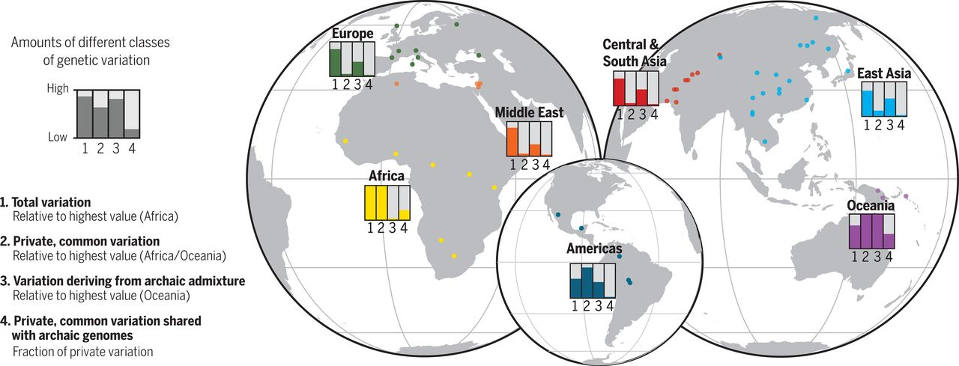
Human Genome Variation
Global genetic variation (929 genomes)
All humans are 99.9% genetically identical
67.3 million single-nucleotide polymorphisms
8.8 million small insertions or deletions (indels)
40,736 copy number variants
Bergström et al. SCIENCE 20 Mar 2020.

Slide 6
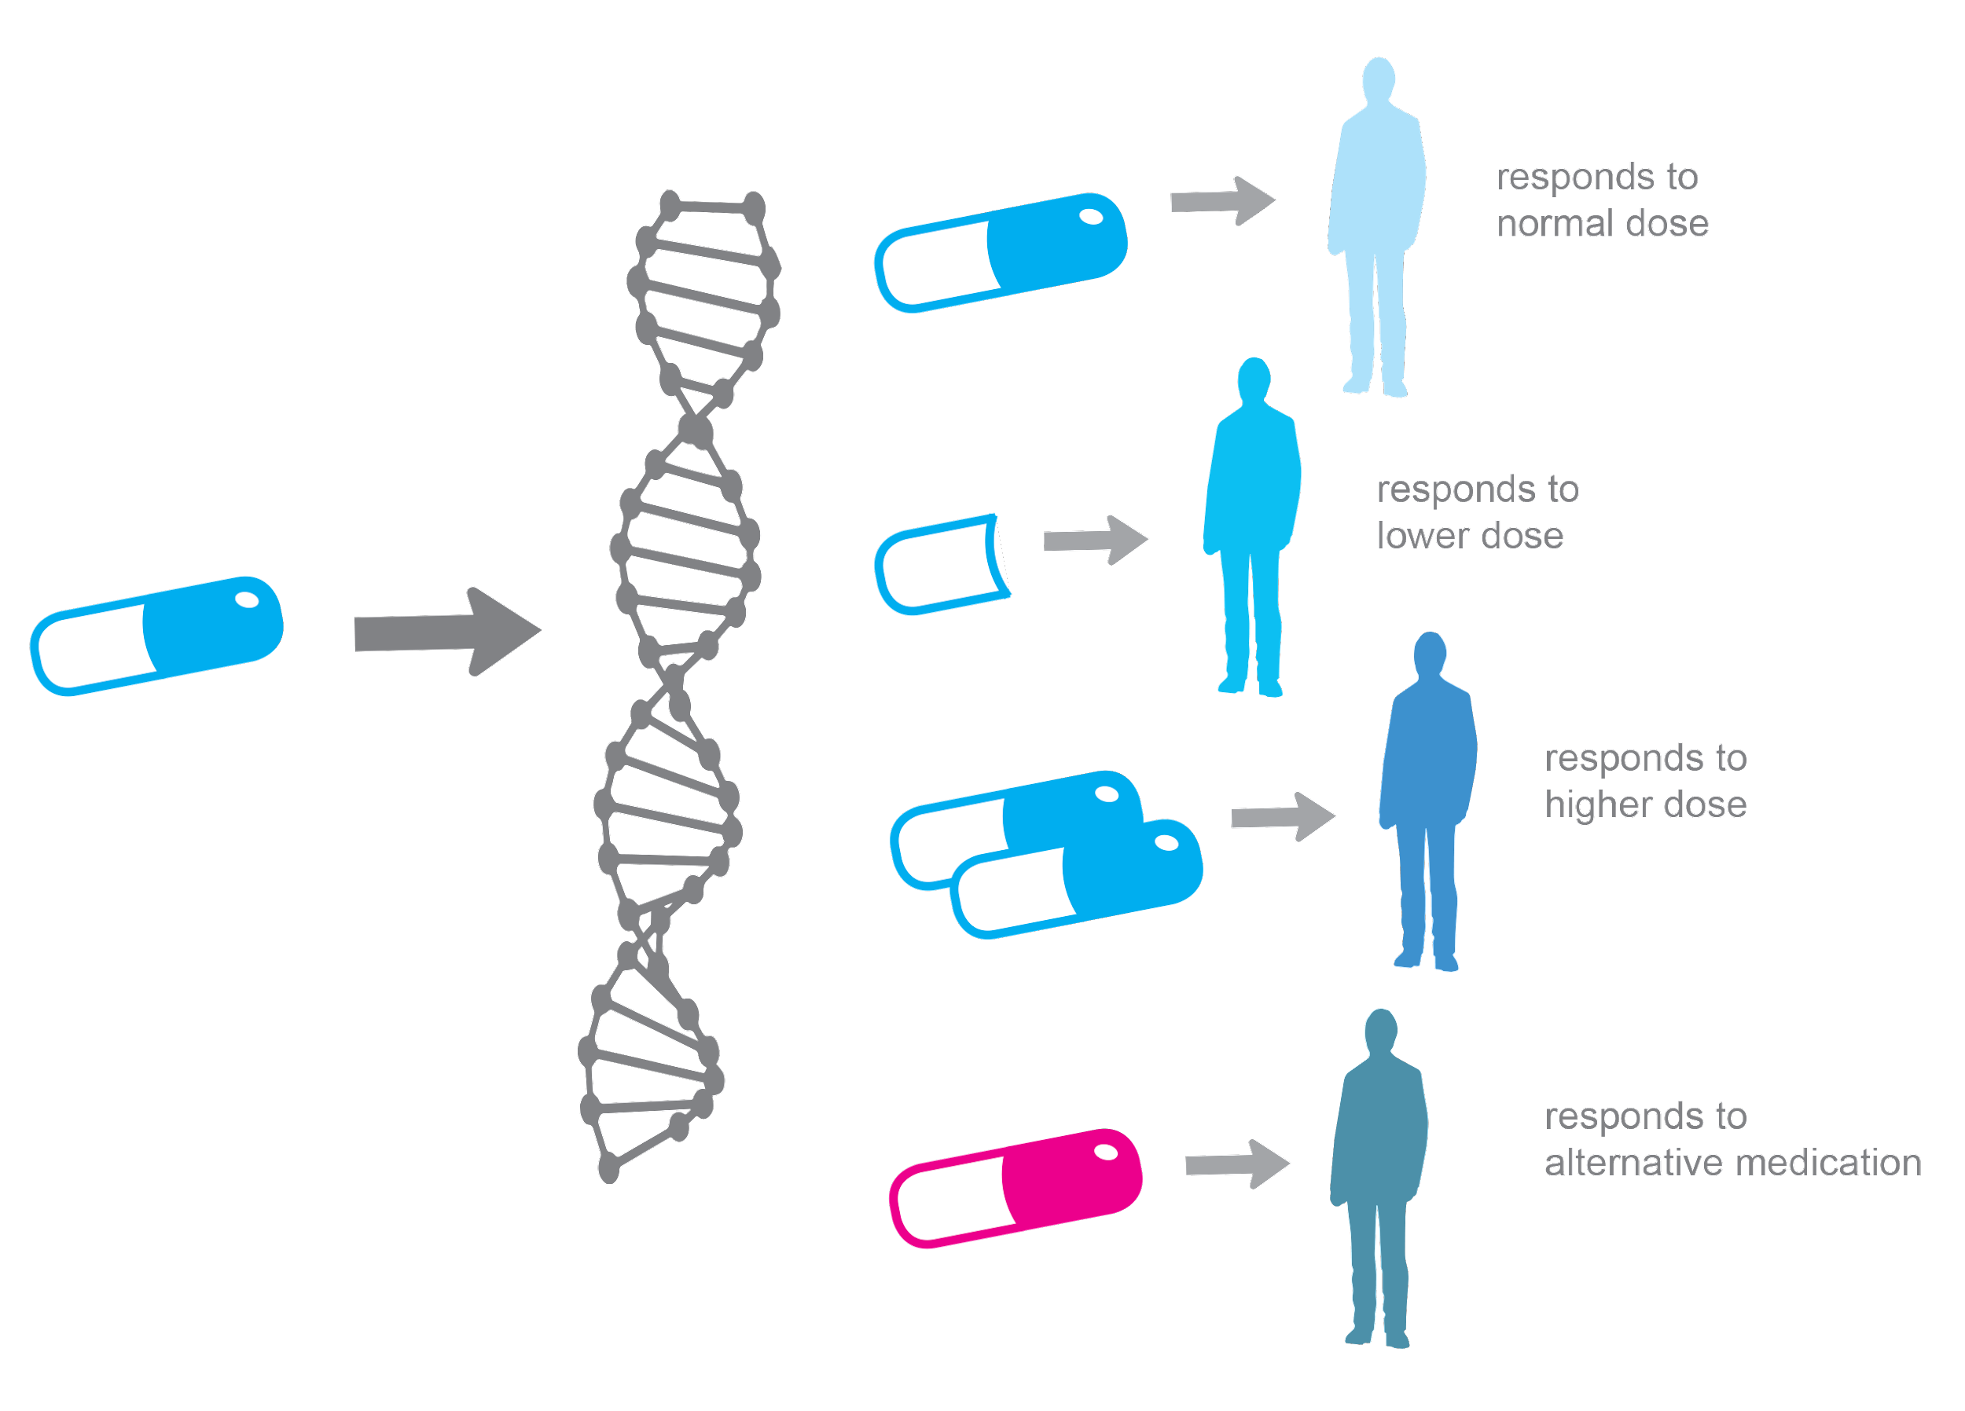
Personalized Medicine
All human diseases are influenced by genetics
Personalized Medicine = Medical care informed by an individual’s genetic profile
Examples:
Drug prescription
Cancer diagnosis
Cancer therapy development and targeting
Genetic disease screening
Jackson et al. Essays Biochem.3 Dec 2018.
https://alphagenomix.com/empowering-personalized-medicine/

Slide 7
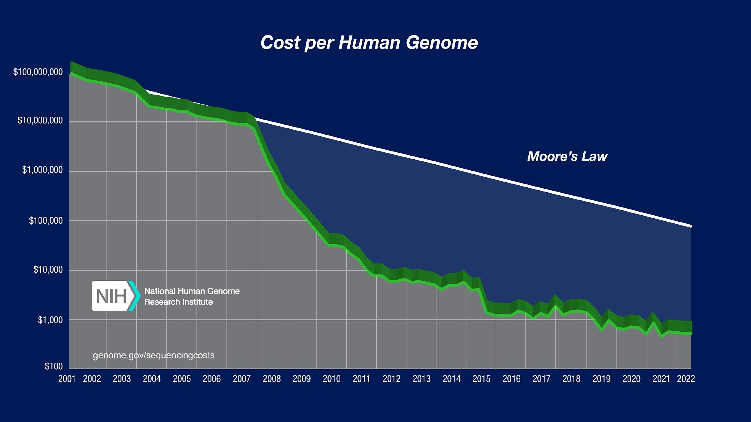
Sequencing Costs
Currently ~€300 per genome
https://www.genome.gov/about-genomics/fact-sheets/Sequencing-Human-Genome-cost
Per-base cost of sequencing has been dropping by half every ~5 months

Slide 8


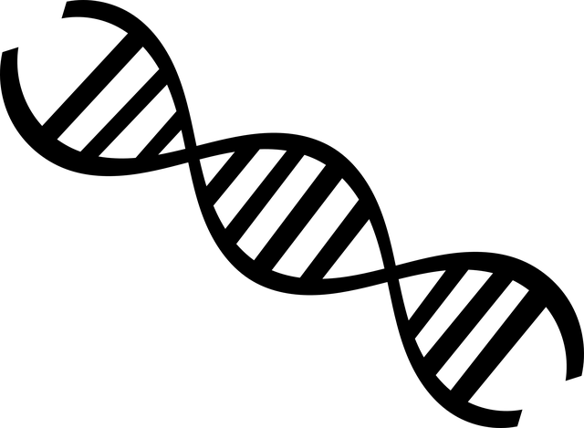
Research Context
Challenges to personalized medicine?
Genome storage and querying
Why?
~3 BILLION base pairs
Privacy concerns
Genome storage
Stored data querying

Slide 9
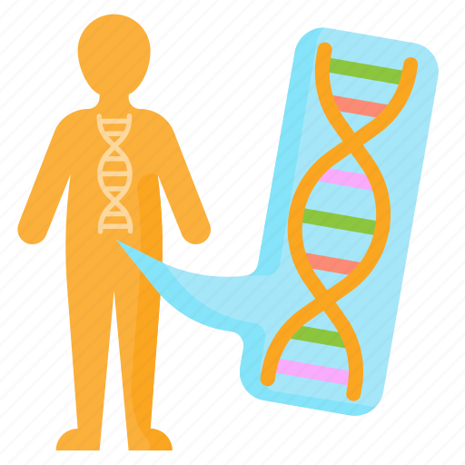
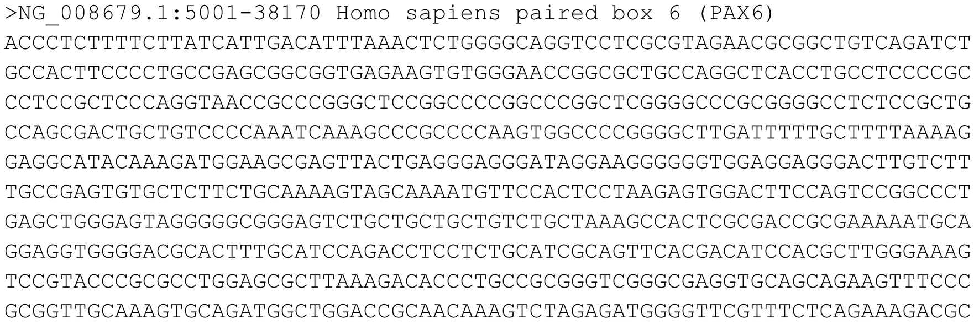
How do we go from:
To this?

Slide 10
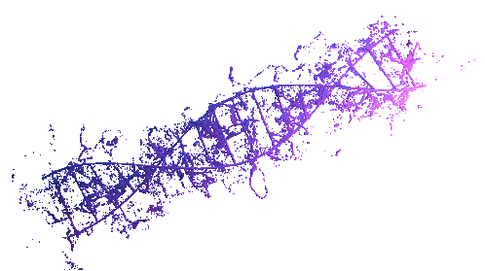
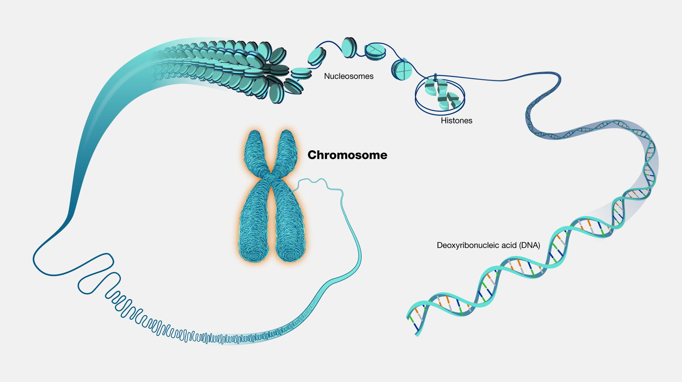
The VERY basics:
Deoxyribonucleic Acid (DNA):
2 strands (that are complementary to each other)
At each position contains a nucleotide (base)
A , T , C , G
A-T / C-G
Wound tightly together into chromosomes
Within EVERY living cell of your body (other than red blood cells)
Each human has ~108 x 10⁹ kilometers of DNA
https://www.genome.gov/genetics-glossary/Chromosome
https://www.nigms.nih.gov/education/Inside-Life-Science/Pages/Genetics-by-the-Numbers.aspx

Slide 11
Genome Sequencing
Three Generations of Sequencing Technologies:
1st Gen: Sanger Sequencing (~2000s)
2nd Gen: Shotgun Sequencing (~2005 – Current)
3rd Gen: Long-read Sequencing (2015 – Current)

Slide 12
Quick Genome Sequencing Overview
Most cost-effective strategy currently:
2nd Gen Sequencing
Short Reads (~150 base pairs)
High Throughput (>30x representation of each base in genome)
from Ben Langmead, PhD

Slide 13
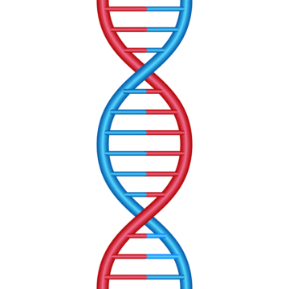
2nd Gen Sequencing Preprocessing
** Most cost-effective strategy currently:
Short Reads (~100 - 150 base pairs)

Slide 14
Quick Genome Sequencing Overview

Slide 15
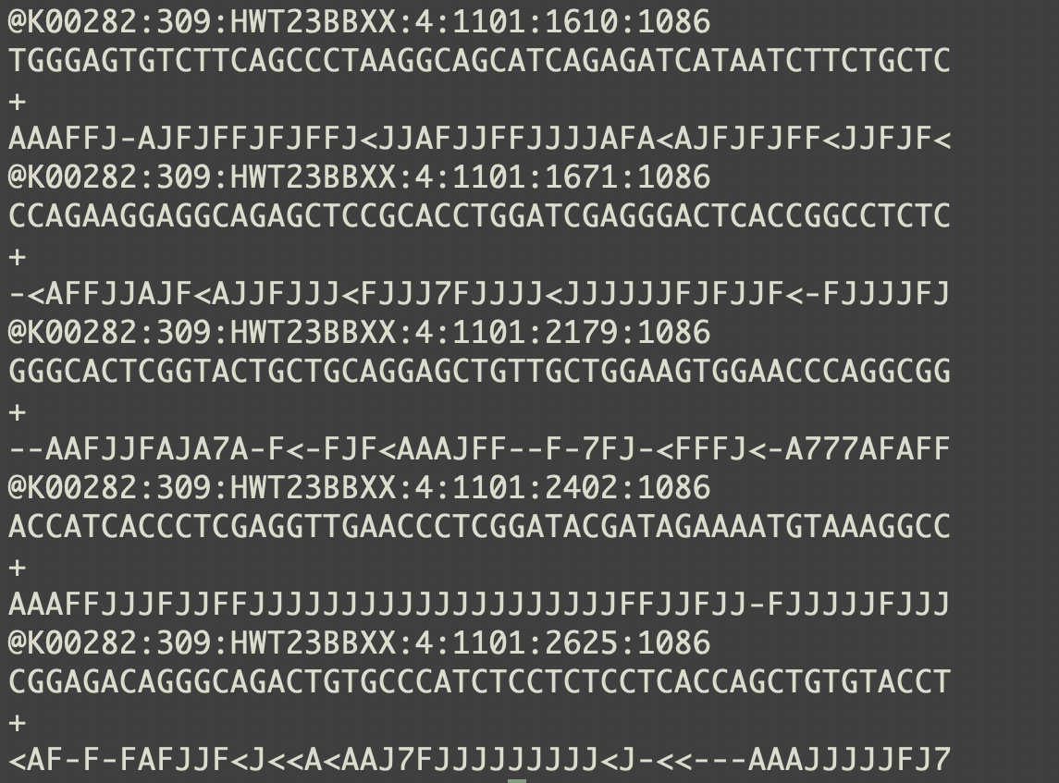
Quick Genome Sequencing Overview
Video with slightly more detail: here

Slide 16


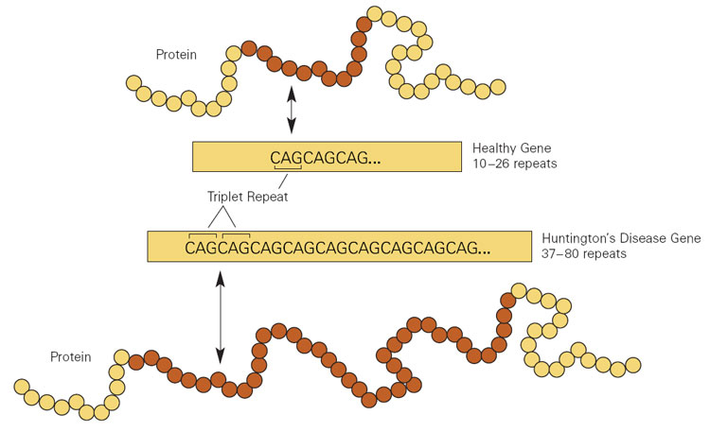
Sequencing Advances
More about long-read sequencing
Long-read Sequencing
Reads can reach >10⁶ bases in length
Significantly different approaches (than short-read)
Currently significantly more expensive
Combining long-read and short-read sequencing?
More about hybrid assembly

Slide 17
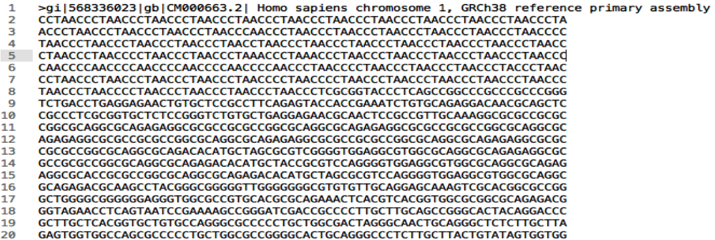
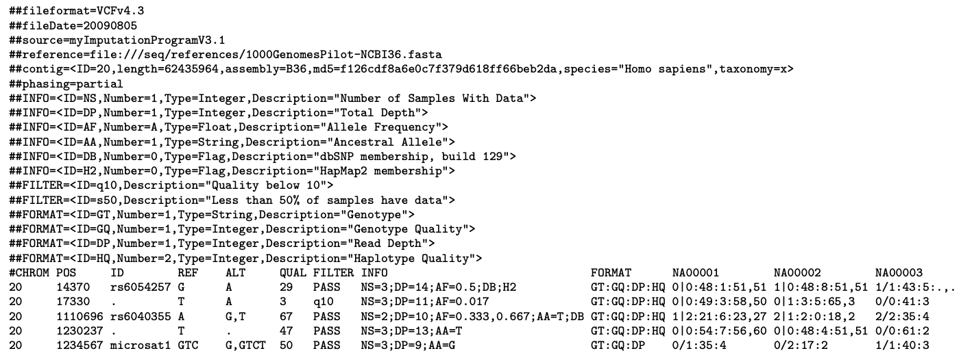
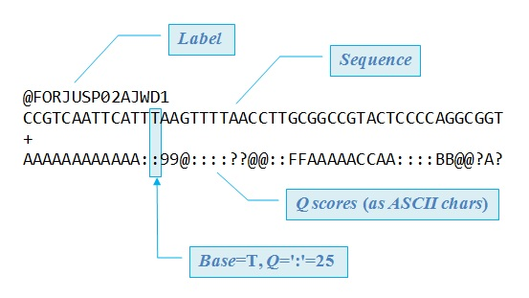
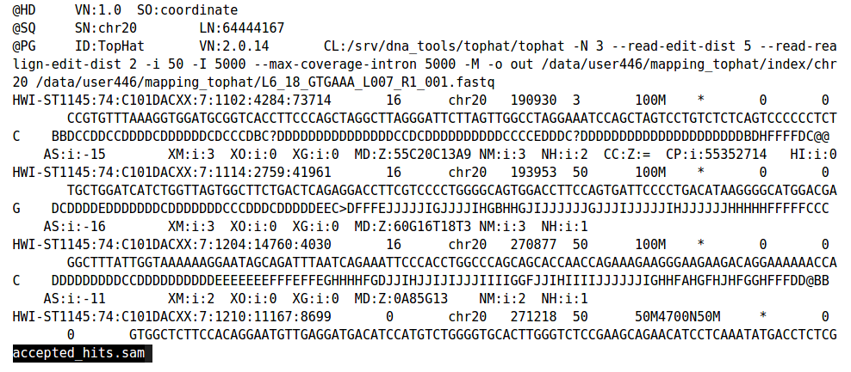
Sequence Data Formats
FASTQ
FASTA
SAM/BAM
VCF
Raw Sequencing Outputs
Contiguous DNA sequence
FASTQ reads aligned to a FASTA reference
Areas in SAM where sample and reference differ

Slide 18
Sequencing Storage
The human genome = ~3 billion base pairs
3 billion letters -- ~700 megabytes
Representative of a single strand of the whole human genome sequence
E.g. : …ATGCCGTAAACAGATGTCA …
Format: TXT file
Raw human whole genome sequence -- ~200 gigabytes
Whole genome sequences typically have >=30x coverage at each base position. (i.e. each base of the genome is represented in the sequence file a >= 30 times)
Format: FASTQ file
Aligned human whole genome sequence -- ~210 gigabytes // ~100 gigabytes // ~15 gigabytes
Whole genome sequence is mapped to a reference human genome and can be stored in various formats. Recent advances have allowed for improved compression.
Format: SAM file // BAM file // CRAM file
Human genome variant file (list of mutations) -- ~125 megabytes
Individual humans only exhibit ~0.1% variation comparatively (~3 million mutations). Variant file records those differences in one individual’s genome compared to the “normal” reference genome.
Format: VCF file

Slide 19
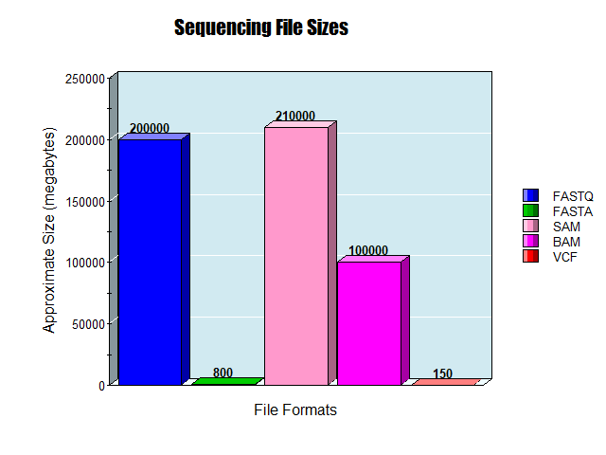
Sequencing File Sizes
FASTQ
~ 200 gigabytes
~ 800 megabytes
FASTA
~ 210/100 gigabytes
SAM/BAM
~ 150 megabytes
VCF
https://nces.ed.gov/

Slide 20
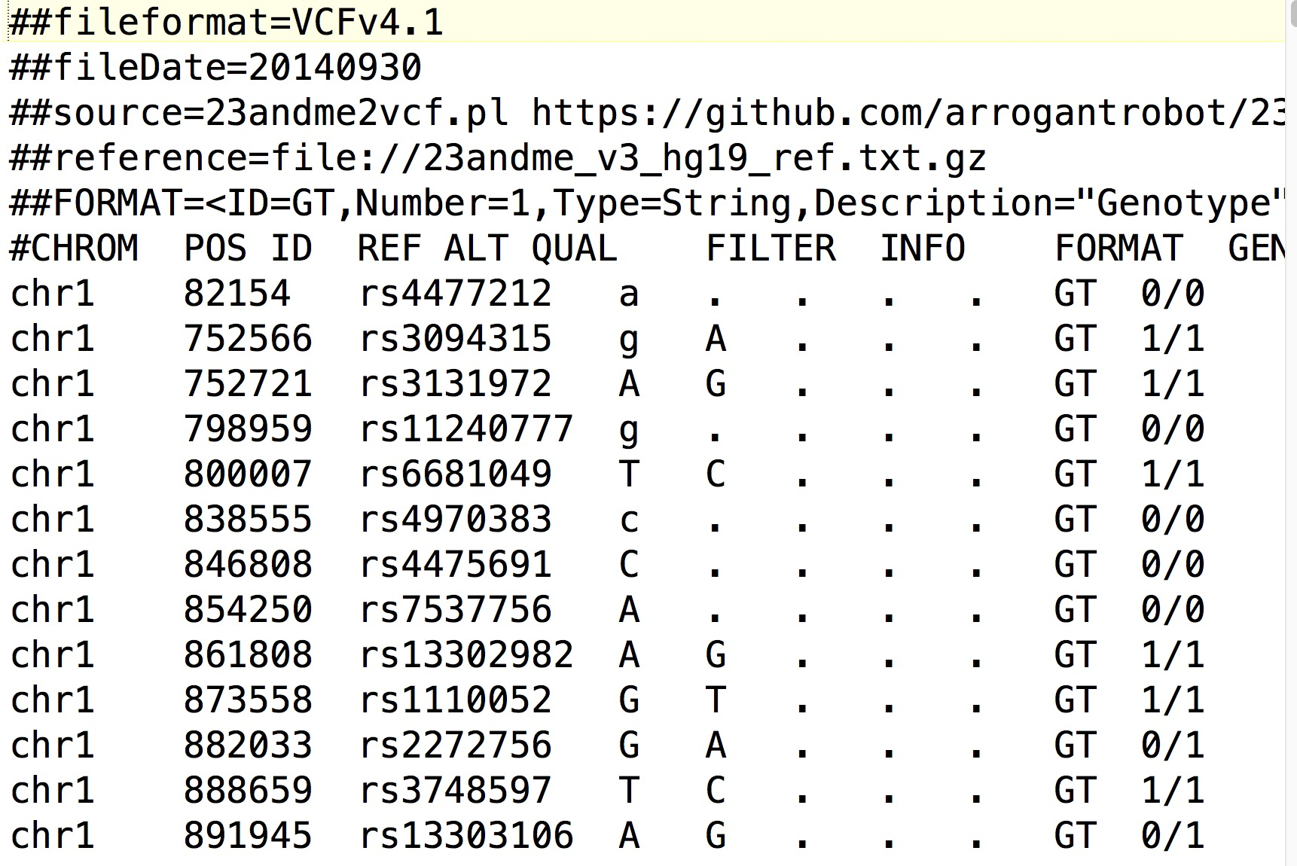
Variant Call Format (VCF)
- tab delimited .txt file
- Rows represent individual mutations in a sequence (when compared to reference)
- Columns store information about that mutation

Slide 21
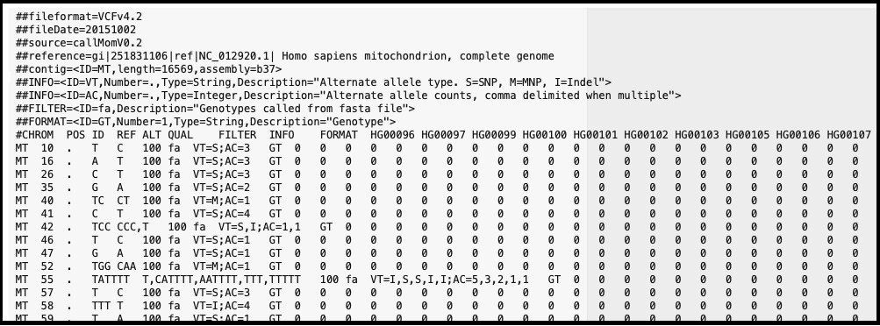
Variant Call Format (VCF)
* Important note: 1 VCF file CAN represent mutations of MANY sequences

Slide 22
Existing VCF Querying Tools?
VCFio
Seqminer2
BCFtools
Tabix --> hybrid of binning and linear index
Made to query 1.000+ VCF (and BCF) files all stored in the same location
Small VCF analysis can mostly be performed by brute-force parsing

Slide 23
Existing VCF Querying Tools?
Tabix Strategy:
VCF File
Indexing
Index file
Shows where variants are stored (binary)
Mutations are placed into “bins”
A “bin” :
Represents a subset of byte locations within a VCF file
== Range of base positions on a chromosome

Slide 24
VCF File:
0
1
2
3
2048 bins at each level
Bins have a hierarchy
Bins contain a subset of mutations represented in the VCF file
Bin memory size is determined by file size
Index contains information about mutation byte offset
→ specific look-up coordinates
Typically, VCF files are .gz compressed

Slide 25
Existing VCF Querying Tools?
Querying Strategy:
Query
VCF File
Indexing
Index file
Bin #n in VCF file
Mutations are placed into “bins”
** Optimized for LARGE datasets of 1000s of VCF files + VCF files representing MANY sequences **
Iterate through lowest bin to find mutation of interest

Slide 26
What if we used linked data strategies?
Architecture of data storage?
What will the links be?
How can we leverage the different architecture?
Query engines? And how will data transfer be handled?

